Slide 1
1 Planed
Planed 1
I planed to finish the assignment1 and 2.
Solved the problems mentioned last week report.
4

Slide 2
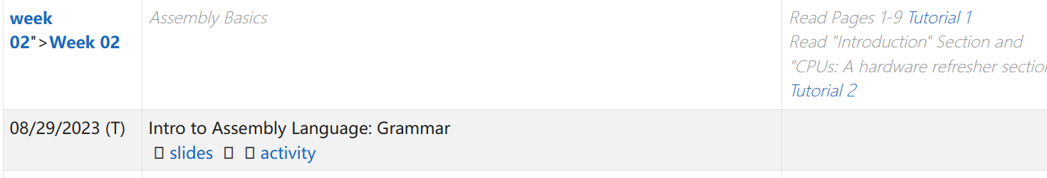
1 Results
Results 1
Have not read the slides in week02, and do not start to do the assignment1.
Solved the problems you mentioned.
4

Slide 3
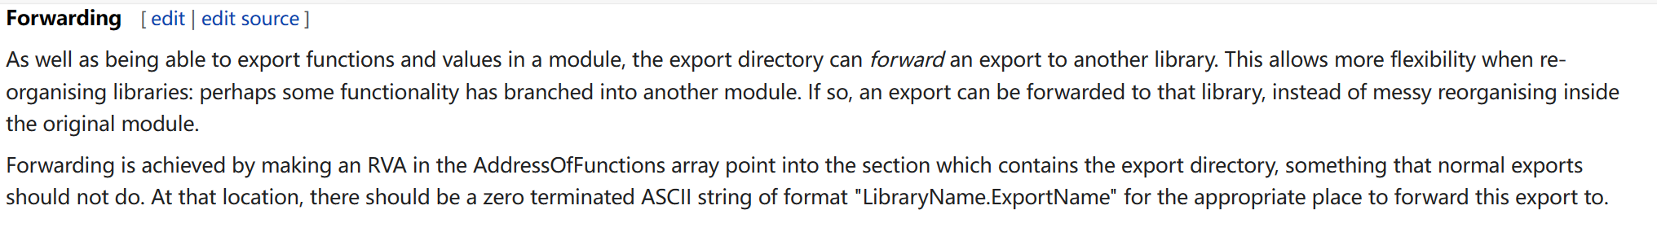
1 Challenges and Solutions
Challenges and solutions 1
I am still confused about some details of export table.
1. If dll1 use the function exported by dll2 then the export name in dll1 follows the format ‘Libirary.ExportName’. The function address obtained by this name can not just plus the ‘ImageBase ’ to get the actual function. But where the address points?
4

Slide 4
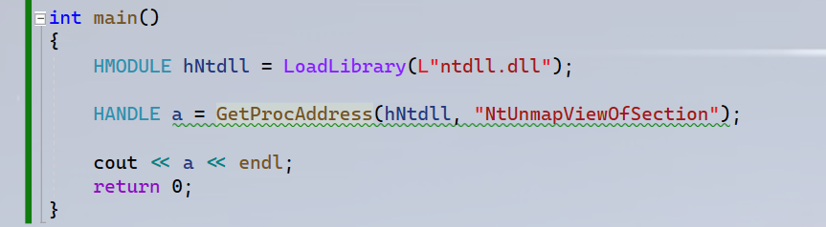
1 Challenges and Solutions
Challenges and solutions 1
The result that I reverse the API ‘GetProcAddress’ the first parameter is the start address of ntdll.dll load in the process. If the function is exported by name and directly exported.
4

Slide 5
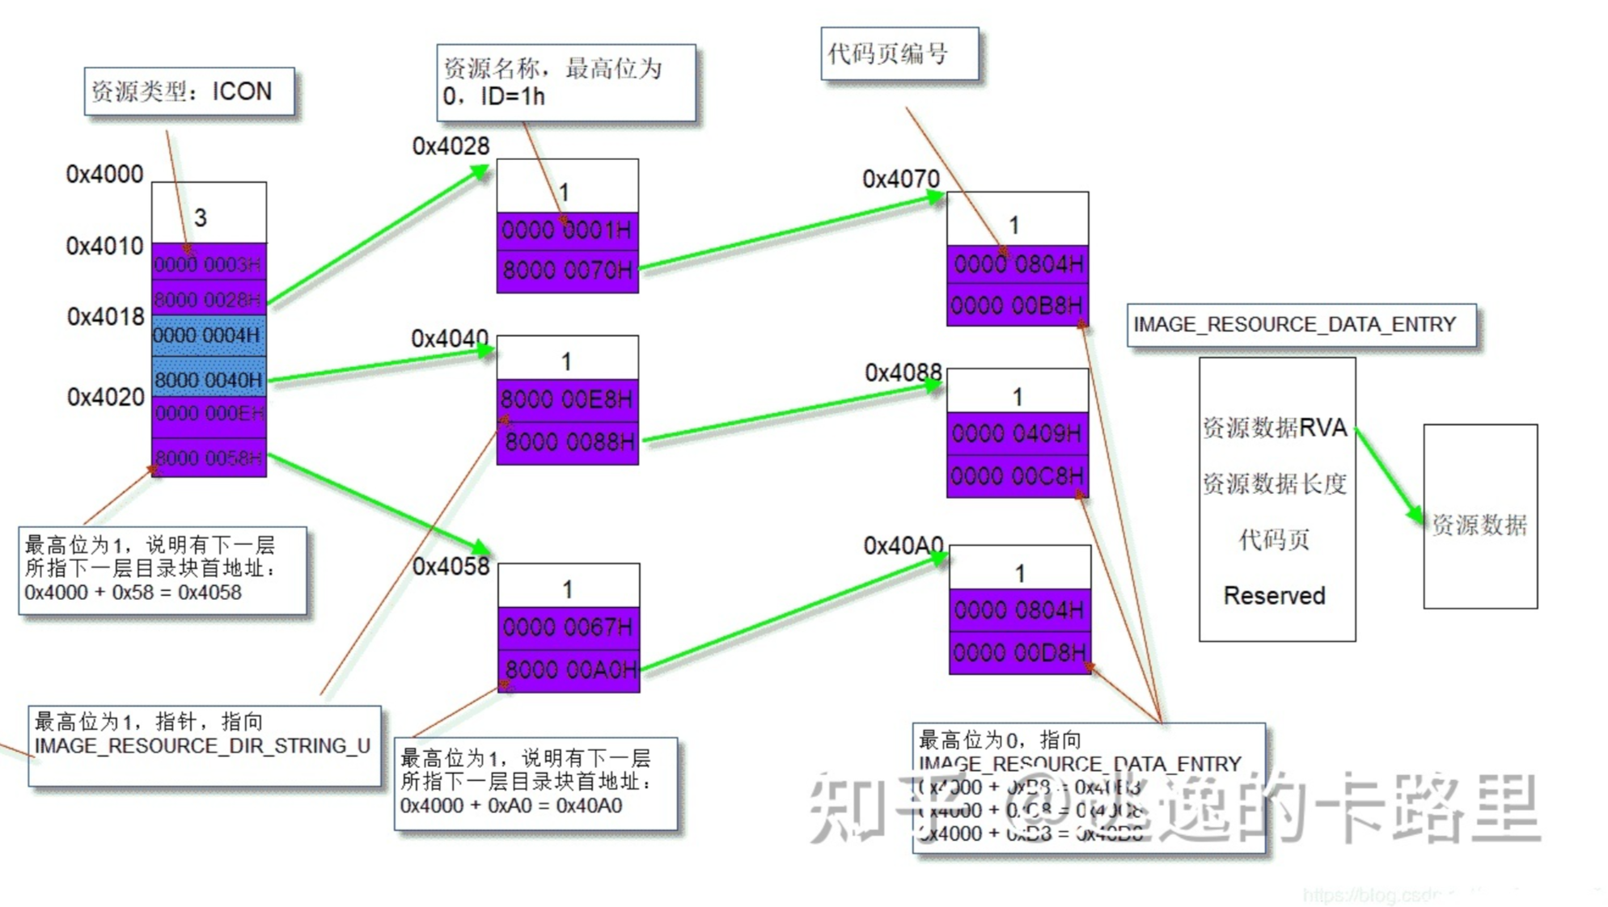
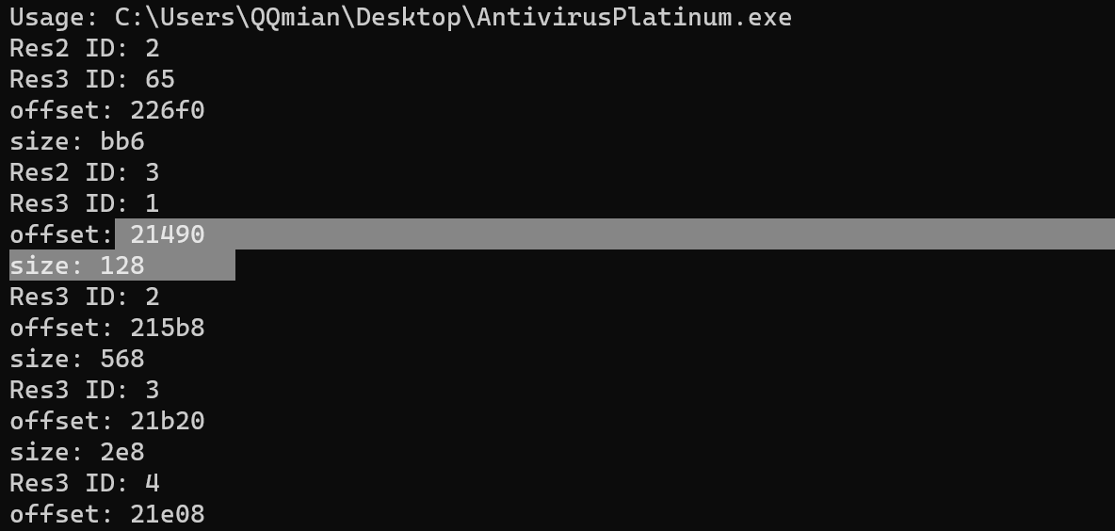
1 Challenges and Solutions
Challenges and solutions 1
I found that there is something wrong, I did not parse the last structure ‘IMAGE_RESOURCE_DATA_ENTRY’ .
4

Slide 6
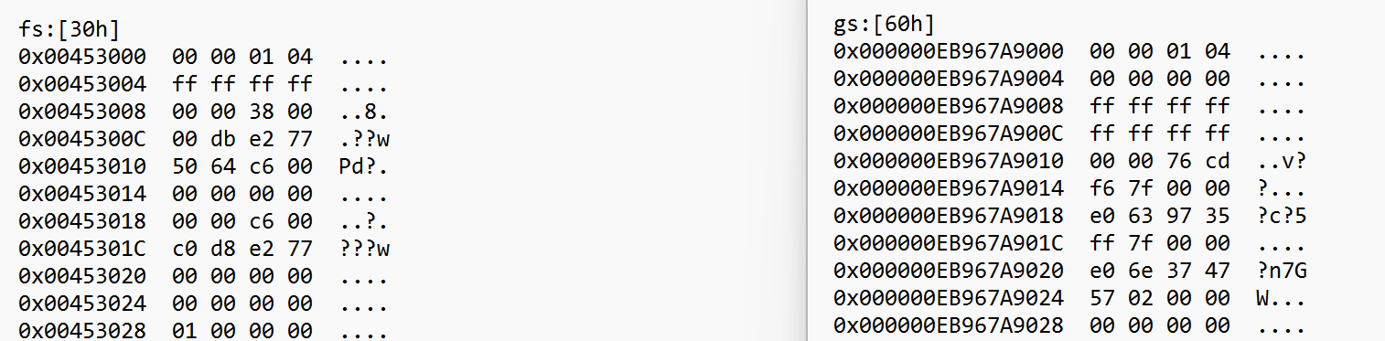
1 Challenges and Solutions
Challenges and solutions 1
The assumption is right! The fs:[30h] in x86 and gs:[60h] in x64 points to the same structure. But I guess the PEB is different between x86 and x64.
4

Slide 7
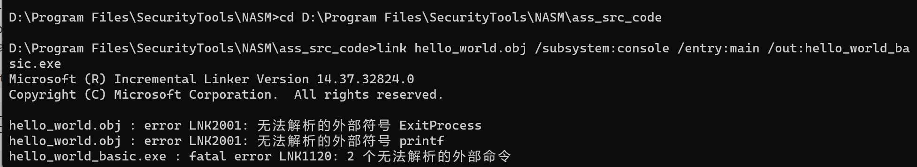
1 Challenges and Solutions
Challenges and solutions 1
What causes this problem I can use the instruction `gcc –o aaa hello_world.obj` to create a aaa.exe. But I can not use the instruction `link`.
4

Slide 8
1 Plan
plan 1
Next week I plan to finish the Assignment2 and 1.
I plan to finish the study of the course you teach before January.
4

